Slide 1
Top Tech stocks Report
K.S.ABISHEK
SRI SAIRAM ENGINEERING COLLEGE
2ND FEBRAUARY , 2023

Slide 2
Project analysis slide 2
Report Structure
Summary
Findings
Report
Data profile Overview
INTEL CASE STUDY
SUGGESTIONS
REFERENCES

Slide 3
Project analysis slide 3
Summary
Briefing
Timespans
Parameters
Scripting
Dashboard
13 stocks of top tech companies have been analyzed from a dataset containing over 45,000+ rows of data
The dataset contains around 13 years of data , beginning from 2010 upto the final quarter of 2022.
Dataset contains 7 parameters –
6 numerical
2 categorical
1 Date-Time
Python 3 was used to compute change in values of parameters over the years and to build profiling reports
Dashboard was created using Summary Sheet obtained from scripting and is hosted at novypro

Slide 4
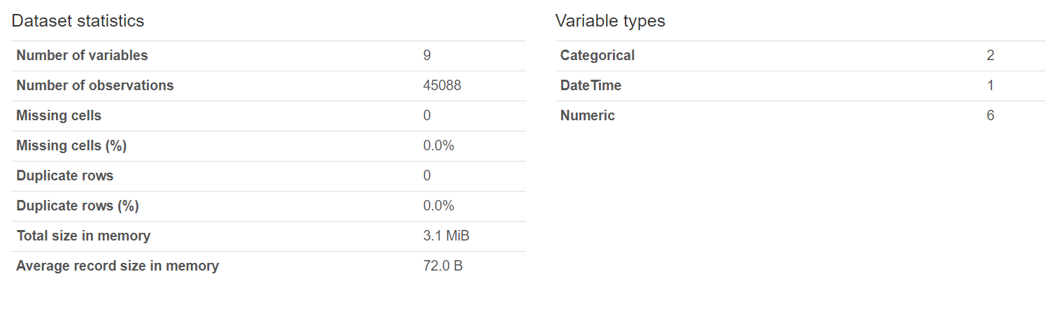
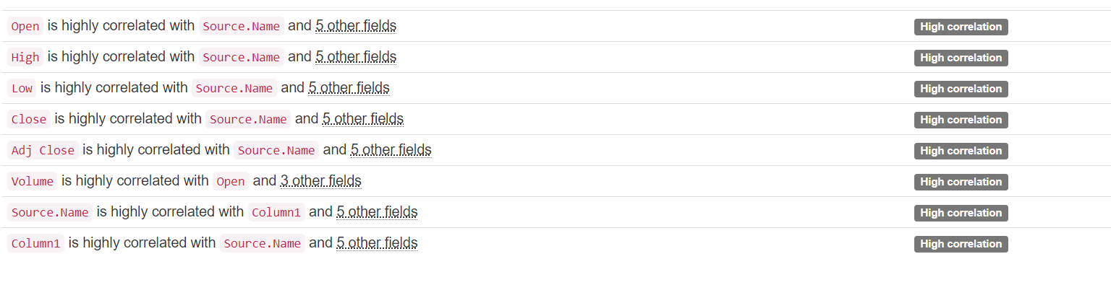
Project analysis slide 4
Data Profile Overview

Slide 5
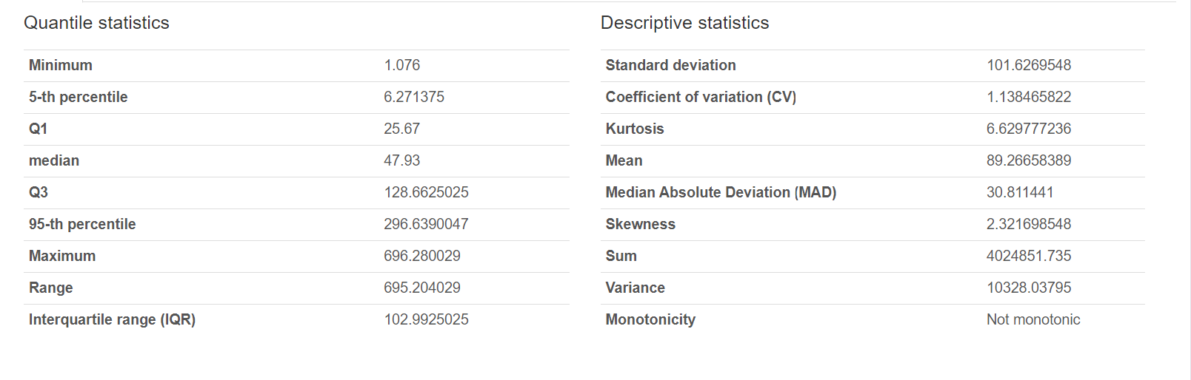
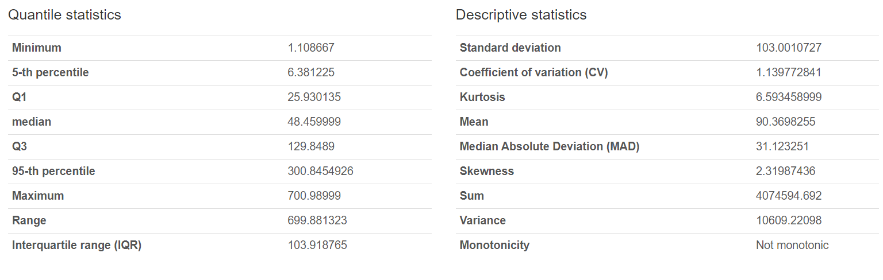
Project analysis slide 5
Parametric Statistics
OPEN
HIGH

Slide 6
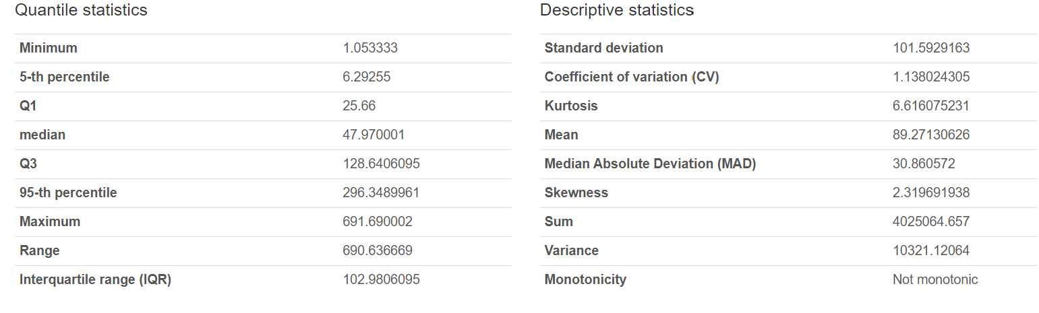
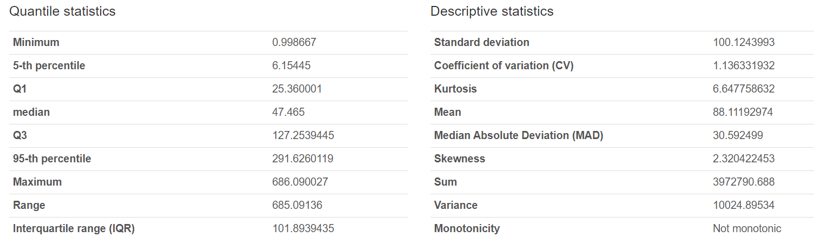
Project analysis slide 6
Parametric Statistics
LOW
CLOSE

Slide 7
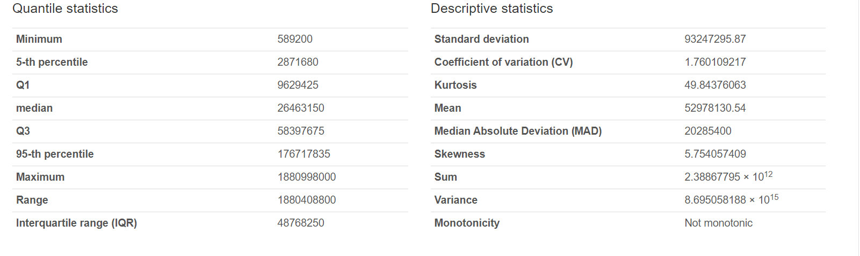
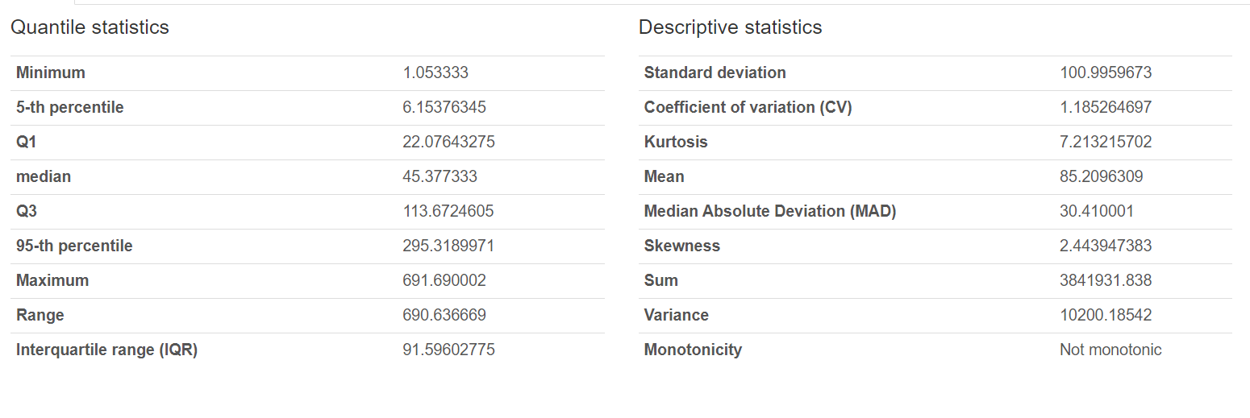
Project analysis slide 7
Parametric Statistics
ADJ.CLOSE
VOLUME

Slide 8
Project analysis slide 8
Individual parametric
changes
ABBREVIATIONS
ADBE – ADOBE
NFLX-NETFLIX
MSFT-MICROSOFT
NVDA-NVIDIA
AAPL- APPLE
CRM- SALESFORCE INC
META- META
AMZN- AMAZON
GOOGL- GOOGLE
IBM-IBM
ORCL-ORACLE
CSCO- CISCO SYSTEMS
INTC – INTEL CORPORATION
 | Stock | From | To | Mean(High) | Mean(Low) | Mean(Open) | Mean(Close) | Mean(Adj. Close) | Mean(Vol) | Adj.Close Change
1 | ADBE | 2010-01-05 | 2022-12-29 | 188.2551343 | 183.6668899 | 186.0696179 | 186.0678442 | 186.0678442 | 3814062 | 299.879986
2 | NFLX | 2010-01-05 | 2022-12-29 | 191.23405 | 185.2182757 | 188.2973469 | 188.307411 | 188.307411 | 18415213 | 283.761424
3 | MSFT | 2010-01-05 | 2022-12-29 | 101.0610092 | 99.02888988 | 100.0697217 | 100.0937829 | 95.30734244 | 38016349 | 217.31927
4 | NVDA | 2010-01-05 | 2022-12-29 | 51.5190237 | 49.55984023 | 50.57438145 | 50.56957569 | 50.29701837 | 50797192 | 141.725739
5 | AAPL | 2010-01-04 | 2022-12-29 | 51.84587648 | 50.70854781 | 51.27417124 | 51.29715355 | 49.44512234 | 256325536 | 123.094788
6 | CRM | 2010-01-05 | 2022-12-29 | 104.7464687 | 102.0254122 | 103.4458708 | 103.4264112 | 103.4264112 | 6910669 | 113.914993
7 | META | 2012-05-21 | 2023-01-24 | 149.7969669 | 146.0439896 | 147.9136583 | 147.954064 | 147.954064 | 30976286 | 109.11
8 | AMZN | 2010-01-05 | 2022-12-29 | 59.6269456 | 58.19903858 | 58.95314466 | 58.92125378 | 58.92125378 | 88320517 | 77.4455
9 | GOOGL | 2010-01-05 | 2022-12-29 | 49.64884749 | 48.65182208 | 49.15985787 | 49.15918785 | 49.15918785 | 60180969 | 72.834632
10 | IBM | 2010-01-05 | 2022-12-29 | 149.5782413 | 147.3476643 | 148.43451 | 148.4812969 | 113.1583142 | 5036116 | 60.727547
11 | ORCL | 2010-01-05 | 2022-12-29 | 46.70349547 | 45.83791439 | 46.24877675 | 46.26892358 | 42.57923915 | 18015874 | 60.369648
12 | CSCO | 2010-01-05 | 2022-12-29 | 33.80675536 | 33.18952291 | 33.49674926 | 33.50495718 | 28.62789771 | 32688255 | 29.806851
13 | INTC | 2010-01-05 | 2022-12-29 | 36.88004285 | 36.09789907 | 36.48620488 | 36.49709171 | 31.31627086 | 36068108 | 12.196452

Slide 9
Project analysis slide 10
Findings
Adobe has shown the greatest change in the values of adjusted close value since 2010
Adobe has acquired at least 20+ companies since 2010 , the most notable one being FIGMA , acquired on the 15th of September ,2022 for a massive $20,000,000,000 (20 BILLION USD).
Acquisitions in various domains , especially in software & IT have increased Adobe’s market reach and has expanded its customer base.
This could have potentially increased the stock prices of Adobe over the years.
Other companies in the list such as Microsoft , Netflix have also made notable acquisitions and have attempted to diversify their portfolios , thereby explaining their increased stock prices.
Intel Corporation has seen the lowest growth , both in terms of stock parameters and also in terms of YoY growth

Slide 10
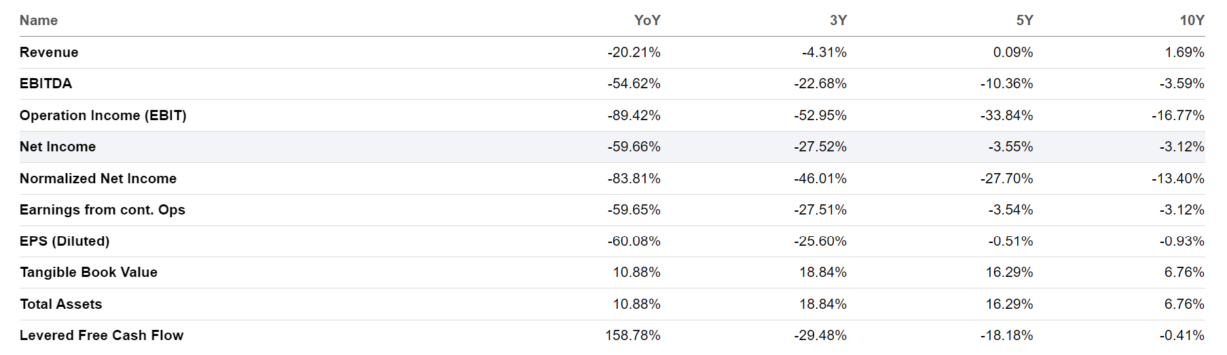
Project analysis slide 10
Findings
Intel has an F grade in sector relative grading with a massive decrease of 20% in YoY revenue.

Slide 11
Project analysis slide 10
Understanding Intel
Intel revenue for the quarter ending December 31, 2022 was $14.042B, a 31.6% decline year-over-year.
Intel revenue for the twelve months ending December 31, 2022 was $63.054B, a 20.21% decline year-over-year.
Intel annual revenue for 2022 was $63.054B, a 20.21% decline from 2021.
Intel annual revenue for 2021 was $79.024B, a 1.49% increase from 2020.
Intel annual revenue for 2020 was $77.867B, a 8.2% increase from 2019.
Intel annual revenue for 2019 was $71.965B and in 2018 was at $70.848B
Year | Revenue | % Increase
2018 | $70.848B
2019 | $71.965B | 1.57
2020 | $77.867B | 7.57
2021 | $79.024B | 1.485
2022 | $63.054B | -20.209

Slide 12
Project analysis slide 10
Findings
Intel income statement breakdown
Intel has six different operating units under its main business structure. They include:
Client Computing Group (CCG)
Datacenter and AI Group (DCAI)
Network and Edge Group (NEX)
Accelerated Computing Systems and Graphics Group (AXG)
Intel Foundry Services (IFS)
Mobileye (MBLY)
For the year 2021, Intel’s sales and revenue totaled $79.02 billion. This represented 1.49% sales growth—a drop from 8.2% in 2020. The cost of goods sold for 2021 was $35.42 billion, a slight increase over $34.46 billion in 2021.
Intel’s gross income for 2021 was $43.81 billion, representing a 0.47% increase from 2020. Intel's net income for 2021 was $19.87 billion, representing a 4.93% decrease from 2020's net income of $20.98 billion.

Slide 13
Project analysis slide 10
Findings
REF: IIDE.CO RESEARCH PAPER
When it comes down in figuring out a company’s losses, a SWOT analysis helps.
Mr:Aaditya Shastri’s paper on Intel’s Marketing Strategy & SWOT Analysis gives some important weaknesses of INTEL CORPORATION.
Overproduction
Business diversification is limited.
Minor presence in the smartphone industry
Dependence on Windows-based computers
I shall further elaborate on each of these points wherever possible

Slide 14
Project analysis slide 10
Findings
INTEL FACES COMPETITON FROM COMPETITORS
Intel’s competitor , AMD rose to new heights by entering into new sectors. Jay Goldberg’s ( SC consultant at D2D advisory )statement hints at lack of manufacturing innovations at Intel.
AMD’s performance has changed drastically in 10 years , according to Goldberg. This caused a massive increase in sales.
Goldberg’s other statement hints at lack of agility at Intel.
AMD’s ZEN range of processors seems to have saved it from bankruptcy , according to analysts.
Due to AMD’s extensive focus in the matters of improving performance , their finances took a turn and their revenue tripled between 2017 and 2021.
AMD’s CEO is credited with the company’s success.

Slide 15
Project analysis slide 10
RECOMMENDATIONS
SUGGESTIONS
Intel can focus on entering new sectors
Intel can focus on bringing innovations in manufacturing and catching up with the fast paced world
Intel can focus on expansion in different countries
ARM chip use is on the rise . Intel can focus on developing these to gain advantage of NVIDIA and AMD.

Slide 16
Project analysis slide 10
REFERENCES
REFERENCES
https://www.macrotrends.net/stocks/charts/INTC/intel/revenue#:~:text=Intel%20annual%20revenue%20for%202022,a%208.2%25%20increase%20from%202019.
https://seekingalpha.com/symbol/INTC/growth
https://www.forbes.com/sites/qai/2022/09/01/intel-stock-breakdown-how-does-intel-make-money-in-2022/?sh=24d74b495372
https://iide.co/case-studies/intel-marketing-strategy/#:~:text=Intel%2C%20thus%2C%20carries%20out%20its,%2C%20attitudes%2C%20interests%2C%20etc.
https://www.ineteconomics.org/perspectives/blog/how-intel-financialized-and-lost-leadership-in-semiconductor-fabrication
https://www.techspot.com/article/2586-amd-rise-fall-renaissance/
https://www.investopedia.com/ask/answers/120114/who-are-intels-intc-main-competitors.asp
https://www.cnbc.com/2022/11/22/how-amd-became-a-chip-giant-leapfrogged-intel-after-playing-catch-up.html

